Slide 1
Welcome to Westview Elementary School 2017-2018
Notes:
This PowerPoint will be used during the back-to-school Open House sessions on August 1st & 3rd 2017. All information grading policy, parent involvement, student handbook, pickup/drop off procedures, and bus route slides must remain the same for each class presentation. The three slides (All About Me, Communication, and Daily Schedule) should be edited by each homeroom teacher to represent their personal information.
All pictures and colors may be edited, as well, but remember do not change any of the information on the school wide slides.

Slide 2
All About Chermin Carnes
Place of Birth: St. Thomas, Virgin Islands
Marital Status: Married
Spouse: Mark Carnes
Children: Morgan Carnes (15) Madison Carnes (1) Big Boi (1)
Military Veteran- Army
Education: UMUC-Business Administration, Troy University-Elementary Education
Motto: You are what you repeatedly do, therefore excellence is not an act but a habit.-Aristotle
Hobbies: Baking, Gardening, Reading, Antiquing
Add personal photos (if you like)

Slide 3
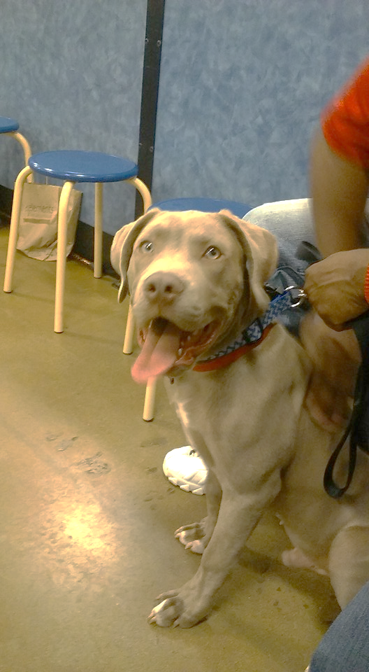
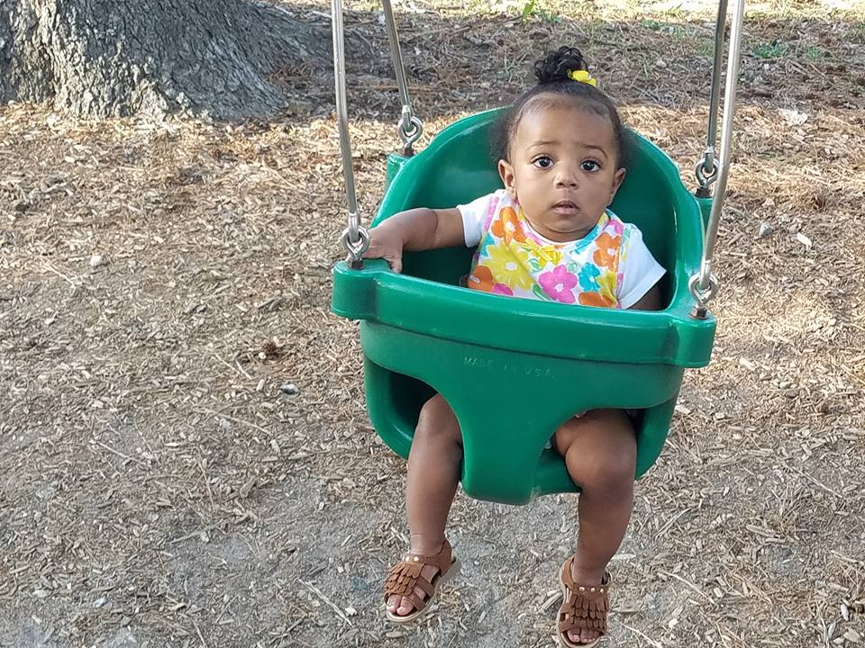
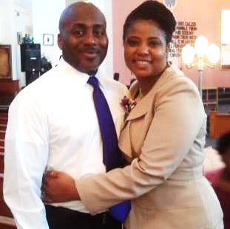

Slide 4
School Information
Principal Assistant Principal Secretary
Mrs. Lewis Mrs. Idel Mrs. Cooley
School Phone School Website
(334) 298-4507 www.pcboe.net/wes
School Hours: 8:00 AM – 3:00 PM

Slide 5
Communication
Teacher contact information:
ccarnes@mypcboe.net
(334) 298-4507
Daily communication:
-Planners/folders,
Phone call (as needed)
- Remind 101
Conferences:
During extended planning period or after
school.
Class website information
http://challcarnes.weebly.com/

Slide 6
Remind 101
Text @e22h4b to 81010
Or
https://www.remind.com/join/e22h4b

Slide 7
Our Daily Schedule
07:30-08:20: Arrival to school, morning work, bathroom break
08:20-08:50: P.E.
08:50-08:55: Bathroom Break
08:55-09:20: DEAR+W
- Every other Tuesday: Art
- Every other Wednesday: Music
- Every Thursday: Library
- Every Friday: Guaidance
09:20-10:45: Block 1 (M-W: Science/Th&Fri: Social Studies)
10:50-12:00: Block 2 (M-W: Science/Th&Fri: Social Studies)
12:00-12:30: Lunch
12:35-12:40: Bathroom Break
12:40-13:00: Block 2
13:00-14:30: Block 3 (M-W: Science/Th.&Fri: Social Studies)
14:30-15:00: Homeroom (DEAR+W/Homework Assistance)
-Once per month students will go to STEM Lab for one week
15:00: Dismissal

Slide 8
Homework Support
Set a time aside for homework EVERY day.
Check your student’s work. Ask him or her questions!
Sign his/her planner every day.
Read every day for at least 15 minutes.
Practice math facts addition, subtraction, or multiplication daily.
Notes:
Inform parents when folders and planners will be sent home. Let parents know which day graded papers will be sent home (usually Tuesday of each week).

Slide 9
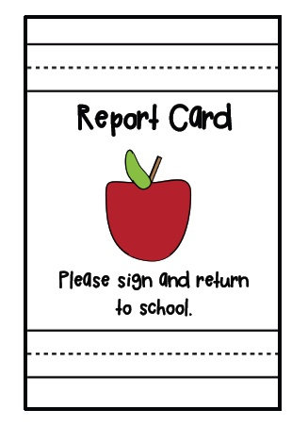
Kindergarten Grading Policy
Kindergarten students earn:
Mastery of Skills -S
Needs to Improve – N
The teachers will share information about goals for each nine weeks via their classroom websites and weekly assignments.

Slide 10
Grading Policy
Grading Scale
Evaluation will be based on a child’s progress towards mastering state and local standards. The following grading scale will be used on report cards:
A-Excellent 90 – 100
B-Good 80 – 89
C-Fair 70 – 79
D-Poor 60 – 69
F-Failing 0 – 59
Grading Periods
1st Quarter August 7 - October 5, 2017
2nd Quarter October 6 – December 15, 2017
3rd Quarter January 4 - March 12, 2018
4th Quarter March 13 – May 23, 2018
Notes:
The dates on this slide are DISTRICT dates for progress reports and report cards. Point out to the parents that the teachers at WES send home WEEKLY progress reports to keep them informed.

Slide 11
Grading Policy
Progress Reports
Students will receive weekly progress reports except the week prior to report cards being distributed. The progress report will be sent home for parents to sign and return to the teacher. Provided no school days are lost due to inclement weather, district scheduled progress reports will be issued on the following dates:
September 7, 2017
November 9, 2017
February 8, 2018
April 26, 2018
Notes:
The dates on this slide are DISTRICT dates for progress reports. Point out to the parents that the teachers at WES send home WEEKLY progress reports to keep them informed.

Slide 12
Grading Policy
Report Cards
Report cards will be given to students at the end of each grading period. The schedule for distribution for each grading period is as follows:
1st Grading Period October 12, 2017
*Parent conference required
2nd Grading Period January 11, 2018
3rd Grading Period March 29, 2018
*Parent conference required
4th Grading Period May 23, 2018
Notes:
The dates on this slide are DISTRICT dates for report cards. Point out to the parents that the teachers at WES send home WEEKLY progress reports to keep them informed.

Slide 13
WES Scholar Expectations
Westview scholars are awesome boys and girls who have the potential to become nurses, lawyers, business owners, musicians, doctors, teachers – or whatever they choose. We must decide to work together as a team (parents & teachers) to hold them accountable for BEING their best and DOING their best at ALL times.
We EXPECT our scholars to be:
RESPECTFUL
RESPONSIBLE
HARDWORKING

Slide 14
WES School Events
Throughout the course of the year, different school events take place which require parent volunteers. Please consider working with us during the year. Some of our school events may include:
Pride Break – all year (Check your monthly calendar)
Grandparents’ Day Lunch - September
Trick or Trunk- (Decorate your Trunk) - October
Fall Carnival – November 17, 2017 (3:00 pm -6:00 pm)
Family Reading Night
Family Math Night
STEM Night

Slide 15
P.E. Information
Students must participate in P.E. activities to earn points each day (unless a doctor’s note is provided).
Students must wear appropriate shoes to P.E. daily.
No shoes can be left in a classroom after the school day has ended.
Physical Education (P.E.) is a real course required by the State of Alabama. Students must meet performance standards and work hard to show growth and improvement throughout the year.
The P.E. grade is IMPORTANT, too!

Slide 16
YEARBOOK Information
Yearbooks are pre-sale ONLY this year. Please order by October 4, 2017 if you would like to have a yearbook in the spring.

Slide 17
Students who arrive late (after 7:59 am) are required to check in on a computer, using the Ident-A-Kid software. For this reason, students MUST be accompanied into the school by an adult, if they are late.
If a student is being checked out, they will also be signed out on the computer. However, a Valid ID must be presented to the secretary and the person must be listed on the student’s STI profile to check the student out.
Visitors to the school, including volunteers, will also be required to sign in using this software.
This computer is located in the front office.
Notes:
Please stress the importance of the parents walking their child into the school when they arrive after 8:00 AM. ALL parents must sign them through the front office. Also let parents know that in order to check out their child, they must provide a VALID ID and anyone checking out must be registered in STI.

Slide 18
Early Warning Truancy
Make sure you have read and signed an Early Warning Truancy form. This document is available online at the www.pcboe.net website and it was available at registration. The document explains why it is important for students to be in school everyday, unless there is an excused absence. The document also explains the steps that will be taken by the court if children do not attend school.
School starts at 8:00 AM.
Notes:
After discussing the Parent Service Incentive Program, tell parents how they can help out in your classroom and around the school.

Slide 19
Student Handbook
Please read through the student handbook that you received at registration. Pay close attention to the attendance policy, grading policy, retention policy, discipline, and bus suspensions. It is a wonderful resource and will answer most of the questions or concerns that may arise throughout the year.

Slide 20
Drop-Off Procedures
Students can be dropped off beginning at 7:20 am. Please drop off at the CLOCK TOWER. Crossing the parking lot is NOT safe.
Please remember, if your student is late (anytime after 7:59 am), he or she MUST be accompanied inside the building by an adult.
Please pay attention to the signs in front of the school.
Cars must NOT park in the bus or car drop off lane.

Slide 21
Pick-Up Procedures
Students can be picked up beginning at 3:00 p.m.
Please do not arrive before 2:55 p.m. This backs up traffic and could pose a problem for emergencies.
PLEASE remain in your car. The car rider line moves faster as staff members learn your car. Be patient the first couple of weeks.
Please WATCH for children while you wait in your car.

Slide 22
Bus Behavior Bus safety is important to us. Please talk with your scholar about behaving and RESPECTING the driver. Riding the bus is a privilege. Students will be suspended if bus rules are not obeyed.
Please supervise your child at the bus stop. Be a community team and take turns waiting with the students at the bus stop.
Notes:
If parents do not know their child’s bus number or route information, please direct them to the LIBRARY before they leave the school.

